Slide 1
District 85 2012 Spring Hangzhou Conference
中国区2012春季杭州峰会
May 11 – 13, 2012
杭州之江饭店

Slide 2
What’s Particular?
The last national convention with all Toastmasters clubs from Mainland China, Hong Kong and Macau;
最后一次中国大陆、香港、澳门的俱乐部在同一个大区的峰会；

Slide 3
What You Can Hear?
Speech from International Champion;
Workshop from experienced members;
Three Sessions of Final Contests with extremely fantastic performance;
Contestants from 16 divisions;
世界演讲冠军主题演讲+工作坊；
来自全国各地资深会员工作坊；
英文演讲比赛+英文即兴演讲比赛+中文秀演讲比赛；
来自全国16个中区的优秀演讲选手；

Slide 4
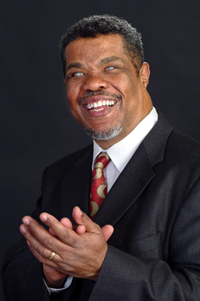
Keynote Speech: Making Your Toastmasters Experience Meaningful
Education Program: Make the Message Memorable
1992 World Champion of Public Speaking in Toastmasters
African American Administrative Law Judge for the California Department of Social Services Accredited Speaker by Toastmasters International
Author of three books for inspiration and personal development
1977 graduate of the University of Southern California Law Cente
1974 graduate of Yale University, B.A. in math
Dana LaMon

Slide 5
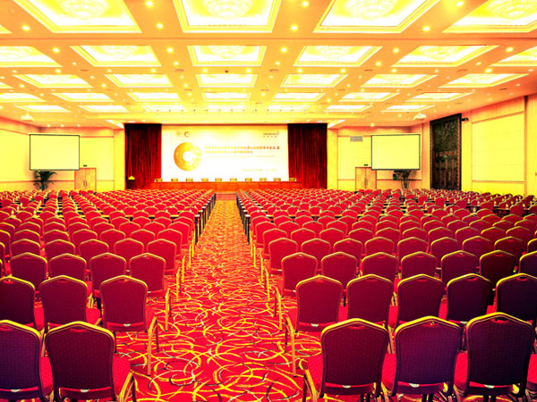
杭州之江饭店;
Main Hall:
Qian Ren Hui Tang
主会场：
千人会堂

Slide 6
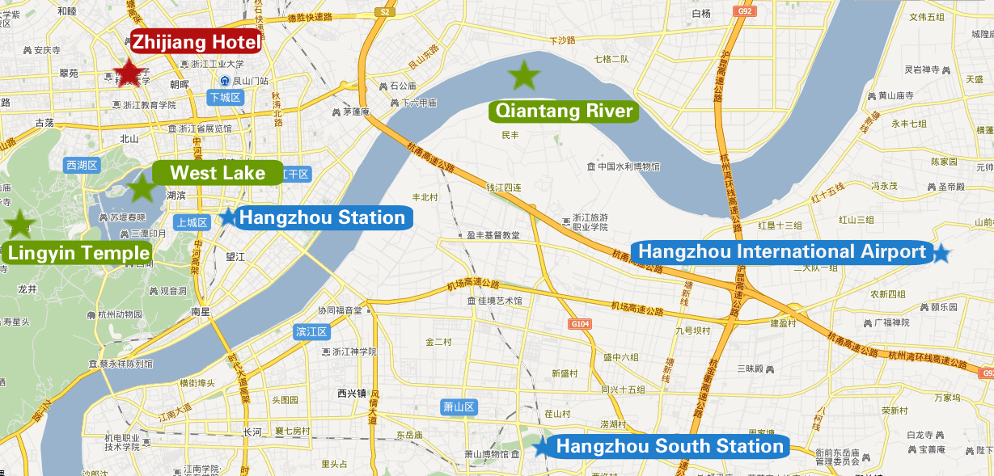

Slide 7
First Round： RMB 518
Global Price: USD 100
 | Price (RMB) | Deadline
1st Round | 518 | 29-Feb
2nd Round | 568 | 30-Apr
Final | 600 | 13-May
户名：李洪昌 (Choice Lee, Phone: 13857152830, Email: hz.tmc.ticket@hotmail.com)
中国招商银行杭州分行, 账号：6225 8858 6353 7965

Slide 8
Welcome to Hangzhou
Conference Chair: Kenneth Wang (tmckenneth@gmail.com)
Ticket Officer: Choice Lee (hz.tmc.ticket@hotmail.com)
新浪博客：http://blog.sina.com.cn/u/2624499844
新浪微博：Toastmasters_2012HZ_Conference

